Slide 1
اسم الطلاب: نايف جمال طارق صقر عاصم محمد نور المحمدي
الصف: ثالث ثانوي
الشعبه : صحه وحياه
Project:
Essential Inventions in Our Daily Lives.

Slide 2
Introduction Modern inventions are an essential part of our daily lives, making tasks easier and saving time and effort. In this project, I will present some inventions that have become indispensable in homes and discuss their importance.
Selected Inventions:
1 . Microwave
2 . Washing Machine
3 . Hair Dryer
4 . Electric Fan

Slide 3
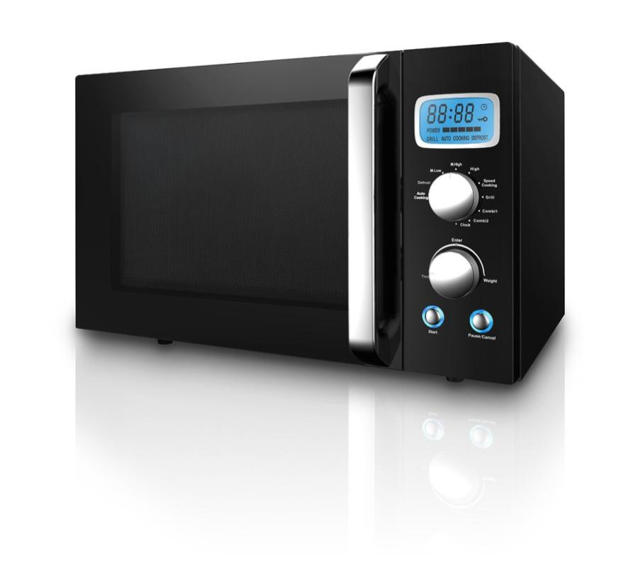
Invention Details
1. Microwave
History: Invented in 1945 by Percy Spencer.
Advantages: Time-saving, easy to use.
Use: Quickly and efficiently heating food.
Rate of Necessity: Highly essential for families relying on quick meals.
Disadvantages: Energy consumption, potential impact on food nutritional value.

Slide 4
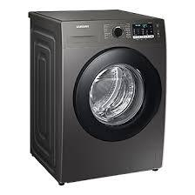
2. Washing machine
Invention Details
History: The first automatic washing machine was developed in the early 20th century.
Use: Efficiently cleaning clothes.
Advantages: Saves time and effort compared to hand washing.
Disadvantages: Water and electricity consumption.
Rate of Necessity: Indispensable in modern homes.

Slide 5
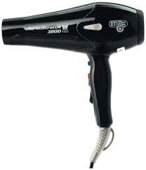
3 . Hair Dryer
Invention Details
Rate of Necessity: Essential for quick personal care.
Disadvantages: Can cause hair damage with excessive use.
Advantages: Speeds up hair drying.
Use: Drying and styling hair.
History: Invented in the 1920s

Slide 6
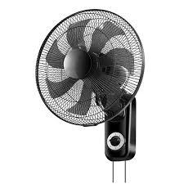
4 . Electric Fan
Invention Details
Rate of Necessity: Very important in hot regions
History: Appeared in the late 19th century.
Disadvantages: Less effective in extremely high temperatures.
Advantages: Low cost and good efficiency.
Use: Providing ventilation and cooling the environment.

Slide 7
Conclusion
These inventions are clear examples of how technology facilitates our daily lives. Despite some disadvantages, their benefits make them indispensable tools in any home.
Additional Tips
Ensure the presentation slides are simple and well-organized.Use clear titles and concise bullet points for each slide.Insert images in the indicated positions to make the presentation more engaging.Review the text carefully to ensure it is error-free.

